Slide 1
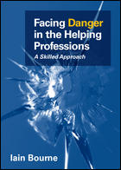
Difficult, Disturbing & Dangerous Behaviour
A dramatic training workshop
designed and delivered by Dr Iain Bourne
www.dangerousbehaviour.com
www.facebook.com/facingdanger
@facingdanger
www.linkedin.com/in/iainbourne
impact@dangerousbehaviour.com

Slide 2
RESOURCES MENTIONED ON THE WORKSHOP
“Facing Danger in the Helping Professions” by Iain Bourne (2013). Open University Press. www.facingdanger.com
“Gender Matters” by Iain Bourne. https://youtu.be/YTSTWlwiISs
“Blink” by Malcolm Gladwell (2006). Penguin.
“The Gift of Fear” by Gavin de Becker (2000). Bloomsbury.
“The Anatomy of Violence” by Adrian Raine (2014). Penguin.
“Thinking Fast and Slow” by Daniel Kahneman (2011) Penguin.
“The Emotional Brain” Joseph Ledoux (1999). W&N.
“The Biology of Violence” by Debra Niehoff (1999). Free Press.
“The Psychopath Test” by Jon Ronson (2011). Picador.

Slide 3
THE DIFFICULT SCENARIOS 1, 2 & 3
REACTION-ASSESSMENT-RESPONSE
 | REACTION – what is the affect of the behaviour on you -emotionally and physically | ASSESSMENT – what is driving their behaviour, what sense can you make of it and what are the risks? | RESPONSE – what could you do to respond appropriately and effectively?
ANDY
BRIAN
CRAIG

Slide 4
ORIENTATION
Facing danger is not part of the role, but a hazard accompanies it. It should not be accepted, but does need to be managed
Carry out, risk assessments, share information, and actively follow policies, procedures and practices
Professional practice involves being alert to danger and minimising that danger
It is always preferable to withdraw, consult, alert others, remove those at risk, and seek back-up than to deal with danger alone
When faced with danger use “Front-end Skills” not Crisis Resolution or Conflict Management Skills
Use Defusing, De-escalating and Rapid Reaction Skills according to the degree of danger. Dealing with the problem/issue comes later.
Be generous and respectful to the person but firm and resolute on the issue
If the person tries to negotiate or argue use the “Broken Record Technique”
Always do something: not more, less, but always something
Do not allow dangerous and/or uncontrolled behaviour to take control – but keep it simple

Slide 5
Danger Zones
YELLOW
Based on General Risk Assessment
AMBER
Based on unexplained changes
RED
Based on sudden escalation or change
Be prepared and vigilant
Stop and investigate
De-escalating skills
GREEN
Practice as usual
Stay up to date and use supervision
Safe, time to think, wide variation in options, wide margin for error
Amber and Red Alerts signal a need to switch to “Front-end Skills”
Unsafe, no time to think, limited options, little margin for error

Slide 6
Drivers of Aggression (Bourne, 2013)
Reactive Aggression
Driven by Emotion.
Driven by Disturbance
Driven by a Goal
Disturbed Aggression
Pro-active Aggression

Slide 7
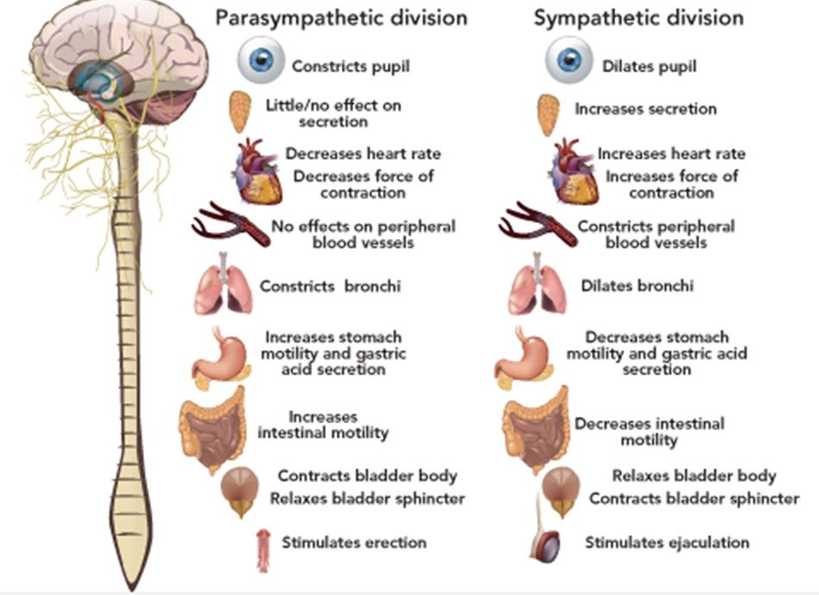
The Autonomic Nervous System
Slow Down. Speed Up

Slide 8
The Instant Aggression Model (Bourne, 2013)
 | REACTIVE AGGRESSION | DISTURBED AGGRESSION | PROACTIVE AGGRESSION
DRIVING FORCE | An unpleasant emotional state | A disturbed cognitive or perceptual state | A goal
LEVEL 1 DIFFICULT BEHAVIOUR | Increasing levels of agitation and arousal | Increasing loss of reality and self-control | Increasing need to use threats, intimidation and coercion
PIVOTAL POINT | The Dysphoric Crisis | The Psychotic Crisis | The Psychopathic Crisis
LEVEL 2 DANGEROUS BEHAVIOUR | Highly reactive, largely out of control violent behaviour | Highly disturbed violent behaviour largely controlled by hallucinations, delusions and paranoia | Violence chosen as a means to a clear end

Slide 9
Skills for Reactive Aggression
Rapid Reaction Skills
For explosive encounters
De-escalating Skills
For containing an already aggravated situation
Defusing Skills
For calming an agitated service user
Less time, fewer options, less room for error, greater danger

Slide 10
THE RULES
ALWAYS DO SOMETHING … !
The behaviour is dynamic - it is moving - so doing nothing leaves it to move in a direction that you probably don’t want. It also leaves the aggressor in total of control when they may either be out of control themselves or using that control against you. The catharsis theory (“let them vent”) is only appropriate in situations involving a relatively low level of expressed emotion.
… BUT KEEP IT VERY, VERY SIMPLE!
Most situations go off track when the person dealing with the behaviour does more rather less. They have to have the last word, won’t let it go, feel they have to do more. If ever you find yourself asking “what else can I do?” – stop it! You are about to sink into the quagmire. It is better to just keep doing the same thing rather than complicating it.
TRUST YOUR BODY!
Nonverbal behavior is highly significant but it is also highly complex and cannot be effectively micro-managed. Rather than worry about your gaze, stance, posture etc. trust your body to work these out for you – so long as your intentions are genuine AND you are doing something (see above).

Slide 11
De-escalating to Defusing
FOCUSING & SLOWING
ENGAGING
ASSERTIVE ASSISTANCE
DEFUSING

Slide 12
FROM DE-ESCALATING TO DEFUSING SKILLS
The important thing is to do simple things well - and no more! To achieve this you need to know what you are doing before you get into a situation – it’s like a drill – the “Think” part has to be done on a course like this, while “See” is replaced by the faster “Sense.” These are “Front-end Skills” – the skills you use before exercising your professional duties. You do not need to know what has led to the aggression, simply how to contain it. Below is a simple, respectful and assertive method. Each stage must be completed before moving on to the next.
DE-ESCALATING
STEP ONE
FOCUSING & SLOWING
You cannot influence someone’s behaviour unless they are focused on you. If they are being distracted by others or absorbed in their own world your influence will be minimal. So gain their attention.
The aggressor is likely to running too hot and fast to process anything you might do to address their discontent. So slow them down.
ACT: As soon as you sense the tension rising interject repeatedly with their name or one word – and no more!
DE-ESCALATING
STEP TWO
ENGAGING
As soon as an entry point is achieved engage the aggressor quickly
This locking in process requires that the aggressor feels a. they are being treated as a unique individual; b. that their distress has been communicated; c. that you are on their side; d. that it is easier to work with you than against you; e. their will be no loss of face.
ACT: Spoken with sincerity “I can see you are (e.g. upset) and I want to help you ..” is an effective communication
DE-ESCALATING
STEP THREE
ASSERTIVE ASSISTANCE
It is essential that the offer of assistance is accompanied by a simple condition that could be acted on immediately and before the aggressor has time to think not to follow it.
Neither conditions nor boundaries should be negotiated but simply stated.
ACT: e.g.“Please step back.” Use the “Broken Record” technique – otherwise terminate contact and follow-up later
DEFUSING
This is all about slowing down further and using all your attending skills to allow the aggressor to get their message across. Just listen, prompt, paraphrase and summarise regardless of how much you agree with the aggressor. In the end agree together how to proceed.
ACT: e.g. “Come with me” “Let’s sort this out” “Take your time” “Start from the beginning” etc but do not correct or disagree
Always be generous with the person but firm on the issues. Depersonalise the issue but personalise yourself. Use collective terms “we”, “both”, “us”, “together”. Do not try to resolve the issue until all the above steps have been completed. The golden rule is “Always do something; not more less but always something.” Do not allow the aggressor to take the lead.

Slide 13
THE DANGEROUS SCENARIOS 4 & 5
REACTION-ASSESSMENT-RESPONSE
 | REACTION – what is the affect of the behaviour on you -emotionally and physically | ASSESSMENT – what is driving their behaviour, what sense can you make of it and what are the risks? | RESPONSE – what could you do to respond appropriately and effectively?
ROSS
JOHN

Slide 14
LONE-WORKING PROCEDURES
Check existing Risk Assessments. If none go in pairs or call client to the office
Go through Lone Working Quick Checklist
Have a mobile phone + number of manager, client and other involved professionals
Ensure that a contactable person knows where you are going
Where possible ring client to check they are expecting you – assess risk on phone
On arriving, if it feels wrong, it probably is. Postpone visit if possible.
Look for things that are different – these may invalidate previous risk assessments
Assess at the door. Do not enter until satisfied. Make sure you know who else may be in the property
Until satisfied, keep exits available and do not sit down
Have a reason to leave prepared if you feel uneasy (e.g. “I just need to get my diary from the car”)

Slide 15
LONE-WORKING QUICK CHECKLIST
PURPOSE OF VISIT |  | PERSON BEING VISITED |  | CIRCUMSTANCES
Have you discussed this visit with your manager? | Yes (0) No (1) | Have you met the client in their home before? | Yes (0) No (1) | Is the locality safe for you to be alone? | Yes (0) No (1)
Is the visit expected to be difficult? | Yes (1) No (0) | Do they welcome your involvement? | Yes (0) No (1) | Are there likely to be other people present who could pose a threat? | Yes (1) No (0)
Is the client expecting you? | Yes (0) No (1) | Do they misuse drugs/alcohol? | Yes (1) No (0) | Is the route from your car to the visit is short, safe, and well lit? | Yes (0) No (1)
Do they know why you are visiting? | Yes (0) No (1) | Do they have a history of violence or abusive behaviour? | Yes (1) No (0) | Will colleagues know of your whereabouts? | Yes (1) No (0)
Has anything changed since arranging the visit? | Yes (1) No (0) | Have they made threats to you or other staff? | Yes (1) No (0) | Will you be able to access assistance quickly? | Yes (0) No (1)

Slide 16
SNAP RISK ASSESSMENT
History of Violence
Significant Stress
Changed Circumstances

Slide 17
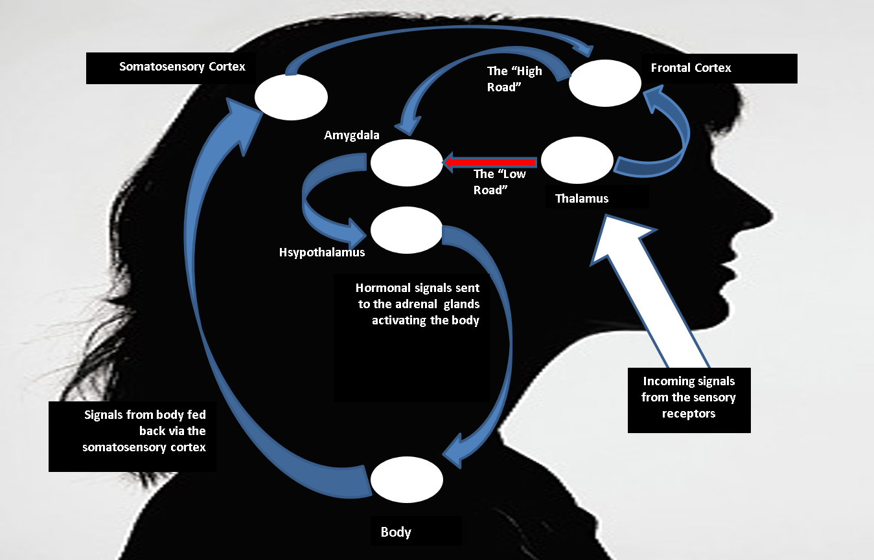
BRAIN & BODY 1

Slide 18
BRAIN & BODY 2
The THALAMUS is responsible for selective attention, and reviews all incoming signals, filtering out “junk mail” and sending important mail to the FRONTAL CORTEX for cognitive processing. If the FRONTAL CORTEX identifies that the incoming information has an emotional component (any signal that requires a bodily response) this is then sent to the AMYGDALA which identifies that bodily response and then informs the HYPOTHALAMUS. In the case of perceived threat, the HYPOTHALAMUS would send hormonal signals to the adrenal glands activating the SYMPATHETIC NERVOUS SYSTEM creating changes in muscular contractions, heightened blood pressure, increased heart rate, narrowing of the visual field and drying of the mouth. These somatic changes are picked up by the SOMATOSENSORY CORTEX which in turn feeds this back to the FRONTAL CORTEX where this is recognised as an emotion:
(“Oh heck” + “look at the state on me” = “I’m Scared”).
This is a normal but (relatively) long process, and not always fast enough for a crisis. Instead, if the THALAMUS identifies incoming stimuli as dangerous, that information is sent directly to the AMYGDALA, by-passing the FRONTAL CORTEX, and our body starts reacting before we can think what is happening. Often this is described as a “gut reaction.” These are DISSOCIATIVE experiences. During violent episodes, the volume of information that needs to be processed immediately is too much for the cortex to handle and DISSOCIATIVE PROCESSES take over. When this happens the HIPPOCAMPUS (not shown here) takes over and our bodies engage in consciously or unconsciously learned SURVIVAL SCHEMAS, or RAPID REACTION SKILLS (Bourne, 2013).

Slide 19
Rapid Reaction Skills: 3 Steps
ENGAGE
INTERVENE
DON’T DO MORE, DO LESS BUT ALWAYS SOMETHING
WITHDRAW

Slide 20
Step One: Engage
The Situation
High levels of arousal; rapidly changing situation; physiological and bodily reactions taking over from cognitive processes
Action
Intervene immediately on thalamic activation
Use a prepared non-toxic vocalisation
Do not attempt to control voice, body, gaze, gesture
Continue until aggressor attempts to readjust or catch up
The Agenda
Channel body’s acute stress response; get on the front foot; allow limbic system to take over; avoid toxic interventions but fill the vacuum
Key Information
Thalamic activation precedes acute stress response; how to avoid tonic immobility; personalised vs. depersonalised aggression

Slide 21
Step Two: Intervene
The Situation
Now your body should be released and the aggressor on the back foot and increasingly reliant on you. They may also be dissociating
Action
Focus on either weapon or space
Use the broken record technique
If no change occurs, introduce the “Implied Suggestion” – but no more
If change occurs do not refer to it
The Agenda
To effect the smallest manageable change in the aggressor’s behaviour that will shift the direction towards greater safety
Key Information
Dynamics and physiology of an attack; Dissociative processes; Line of Least Resistance

Slide 22
Step Three: Withdraw
The Situation
By now the critical moment may have passed, but the situation remains highly volatile
Action
No questions, but keeping talking
Everything you say needs to be infiltrated with collective and inclusive words
Interventions should imply that you are both in trouble together and the problem is “out there”
Actions should be “broadcasted”
The Agenda
To bring the encounter to an end without taking further risks, and to allow the aggressor a face-saving way out
Key Information
The Stockholm Syndrome: Protective Interventions; The way the aggressor looks may not be how they feel – and they may not be aware of how they look

Slide 23
FLORID PSYCHOTIC HALLUCINATIONS
Tactile Hallucinations
Related to chronic illness or withdrawal from a dependent substance
POTENTIAL DANGER
Visual Hallucinations
Related to ingesting or injecting a psychoactive agent.
Auditory Hallucinations
Associated with psychotic conditions:
Especially those that are persistent, persecutory and/or commanding

Slide 24
MANAGING DANGEROUS PSYCHOTIC EPISODES
Prepare
Environment
Assertively clear area of bystanders
Reduce stimulation
Engage
Gain attention and make oneself the focus
Talk loudly to interfere with processing of command and persecutory hallucinations
Reduce Confusion
Offer your name, role and the current location
Keep it simple, continuous, loud but not aggressive
If the behaviour looks like it will suddenly escalate you strong, simple verbal commands
Ground
Intervene
Offer a visual commentary on the immediate environment
Avoid abstract, process-oriented and emotional speech
Use comforting incentives if possible
Resolve
Allow the client to talk. Listen but do not try to correct
Make sure that if they have to return to hospital they have an advocate

Slide 25
CRISIS TEAMWORK
PREPARATION
When working alongside other colleagues in a crisis the potential for undermining one another unintentionally is very high. There therefore needs to be an explicit agreement about how you will work together beforehand. In residential teams this needs to be part of the induction process.
STAYING OUT OF THE QUAGMIRE
Only reciprocal interactions with the aggressor(s) should be followed. If an aggressor does not reciprocate a colleague’s intervention and shifts the attention onto you, do not answer them, simply refer them back to where the reciprocity broke down.
MIND YOUR COLLEAGUES TOES
If a colleague tells an aggressor what they should do, and the aggressor then asks what you think, do not answer, simply tell them “You have heard what has been said.” This confers authority onto your colleague.
TAKE THE PRESSURE OFF YOUR COLLEAGUE IF THEY SIGNAL THAT THEY ARE STRUGGLING
MAINTAIN THE FOCUS WHERE IT NEEDS TO BE
Crises in group situations can be become prolonged and entrenched if everyone is focussing on the aggressor. Instead, colleagues should be focussing on the person who is trying to deal with the aggressor.
If a colleague is being verbally targeted, it may be difficult for them to defend themselves adequately, and it is therefore incumbent on colleagues to draw the aggressor’s attention away from them. Simple statements repeated without elaboration (e.g. “That’s enough”) are likely to be most effective

Slide 26
WORKPLACE PROCEDURES
1. Are they easy to reach? Do all staff know what it sounds like, where it will sound, and whether it goes directly to the police or not?
Interview Rooms
1. Do interview rooms allow for staff to exit without approaching the aggressor?
Reception Area
1. Is it comfortable and well lit, with appropriate reading material? TV
Other Areas
Training & Support
1. Are there particular areas where staff may be more vulnerable (e.g. unlit car park)?
Information Sharing
2. Do all staff know what to do if it is sounded? Who will take responsibility for coordinating a response?
Panic alarms
3. How are staff inducted into and reminded of the panic alarm drill?
2. Are other staff able to look into the interview without drawing the attention of the aggressor?
3. Is there a telephone so that the interviewer can be called to check if there is a problem?
2. Are there multiple exits? Is CCTV installed?
3. Is everything possible done to reduce waiting times? Can entry be controlled?
2. Are there other areas where trouble is more likely to occur?
1. How is information recorded and shared on past incidents and known risks?
2. What is the procedure when a potentially dangerous customer is likely to visit the office?
3. How is information shared between agencies?
1. What training is made available to staff?
2. What emotional support is available to staff after an incident?
3. Is there a known procedure to follow after an incident?

Slide 27
DRAMATIC MENTAL HEALTH TRAINING
DIFFICULT, DISTURBING & DANGEROUS BEHAVIOUR Focus: Facing Immediate Aggression Duration: 1 Day The signature course delivered in a fringe theatre style focussing on personal safety in the face of imminent danger. Defusing & de-escalation skills, managing own acute stress responses, managing uncontained rage, behaviour influenced by alcohol, drugs, and psychosis. Lone-working, residential and centre-based practices. teamwork issues, threats. | CRITICAL TRAINING
EDGE OF DARKNESS Focus: Suicidal Behaviour & Deliberate Self-Harm Duration: 1 Day Using narrated and dramatised case studies the course demonstrates skills in assessing suicide risk, containing immediate suicide risk, working with chronic risk, working with suicide risk influenced by psychotic experiences – as well as looking at epidemiology, ethical issues and support issues. Dissociation, emotional regulation, derealisation and numbing are explored as core concepts in relation to self-harm and out of these strategies for assisting those affected are identified | CRITICAL TRAINING
TROUBLED MINDS Focus: Mental Health Issues Duration: 1 Day A unique look at mental health delivered via “Talking Heads” stories that bring to life the stories behind the service user’s experience. Depression, anxiety, stress, OCD, trauma, psychosis , and personality disorders are looked at (according to course length). In addition, mental health legislation and the mental health system are covered. | ESSENTIAL TRAINING
SPECIALIST MENTAL HEALTH WORKSHOPS Including those covering Anxiety, Stress, Depression, Trauma, Psychosis, Personality Disorder etc. Visit www.dangerousbehaviour.com for further details Or email us at impact@dangerousbehaviour.com | DEVELOPMENTAL TRAINING

